Slide 1

Sales Data Analysis Project
A Step-by-Step Tutorial for Google Colab

Slide 2

Agenda
1
2
3
Import Libraries & Setup
Create/Load Dataset
Data Exploration
Essential tools for data analysis.
Establishing our foundation.
Understanding the raw data.
4
5
6
Data Cleaning
Descriptive Statistics
Visualizations
Ensuring data quality and integrity.
Summarizing key metrics.
Bringing data to life.
7
8
9
Advanced Analytics
Key Insights & Recommendations
Export Results
Deeper insights and correlations.
Saving and sharing our findings.
Actionable conclusions from analysis.

Slide 3
STEP 1: Import Required Libraries
We begin by importing essential Python libraries to perform sales data analysis. These libraries provide powerful tools for data manipulation, numerical operations, and visualization.
import pandas as pdimport numpy as npimport matplotlib.pyplot as pltimport seaborn as snsfrom datetime import datetime, timedeltaimport warningswarnings.filterwarnings('ignore')plt.style.use('seaborn-v0_8')sns.set_palette("husl")
This setup ensures a consistent and visually appealing style for all our plots.

Slide 4


STEP 2: Create or Load Sample Dataset
For this tutorial, we'll generate a comprehensive synthetic sales dataset. This allows us to demonstrate the full analysis pipeline without requiring external data sources.
1000 records: Covering a full year of sales (2023).
Diverse categories: Electronics, Clothing, Books, Home & Garden, Sports, Beauty, Toys.
Multiple channels: Online, In-Store, Phone, Mobile App.
Derived metrics: Gross Sales, Discount Amount, Net Sales, Month, Quarter, Day of Week, Season.
In a real-world scenario, you would load your data using pd.read_csv() or other appropriate functions.

Slide 5
STEP 3 & 4: Data Exploration and Cleaning
Understanding our data's structure and ensuring its quality are critical first steps. We examine the dataset's shape, data types, and initial rows to gain familiarity.
Data Exploration
Data Cleaning
Dataset Shape: (980, 15)
Missing Values: Check and address any gaps. (None in this synthetic data)
Column Names & Types: Verify formats.
First 5 rows: Quick data preview.
Duplicates: Identify and remove redundant entries. (None found)
Statistical Summary: Understand distributions.
Outliers: Handled for 'Customer_Age' using IQR method, filtering out extreme values to ensure realistic insights.
After cleaning, our dataset is robust for analysis with 980 records.

Slide 6
STEP 5: Descriptive Statistics Analysis
We calculate key business metrics and perform category-wise analysis to summarize the sales performance at a high level.
$420K
$428.62
980
40.3
Total Revenue
Avg. Order Value
Total Transactions
Avg. Customer Age
Sum of all net sales
Average net sales per transaction
Number of individual sales
Mean age of customers
Top 5 Product Categories by Revenue
Regional Performance
Books: $69,220.73
East: $93,028.60
Electronics: $68,823.15
North: $92,572.24
Clothing: $60,942.50
South: $83,382.26
Home & Garden: $56,798.81
Central: $82,347.16
Beauty: $55,626.68
West: $69,178.61

Slide 7
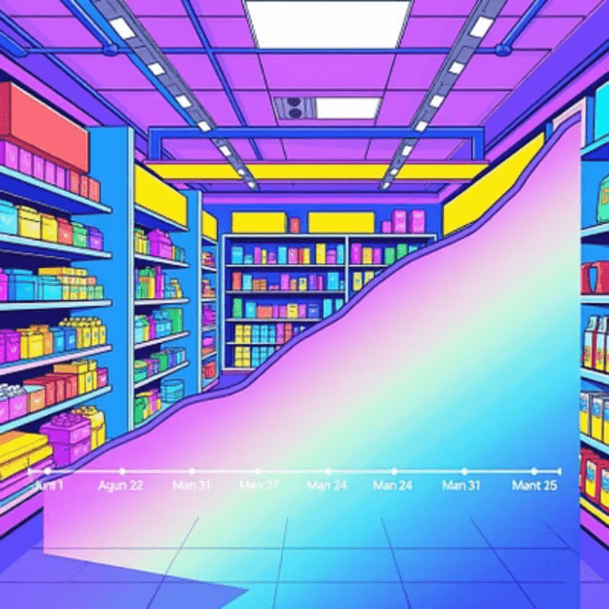
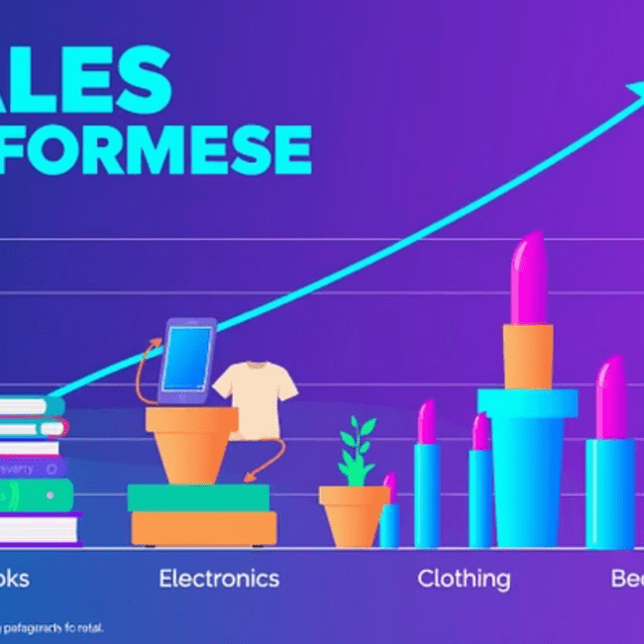
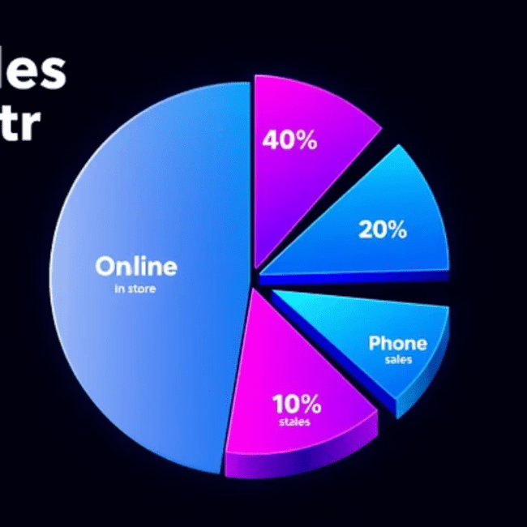
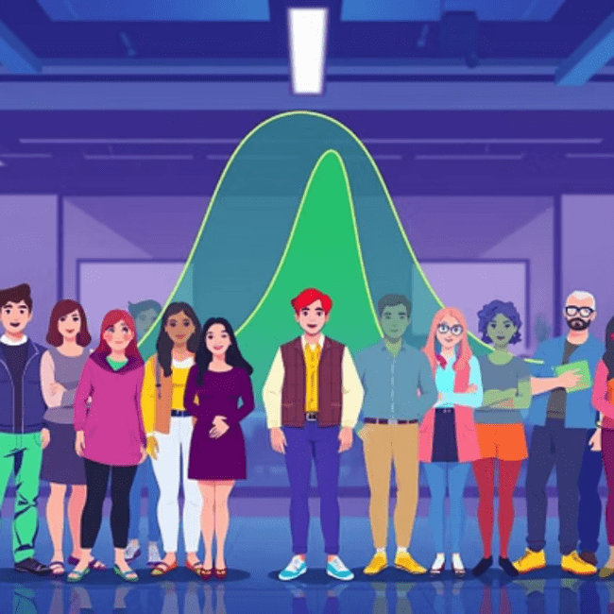
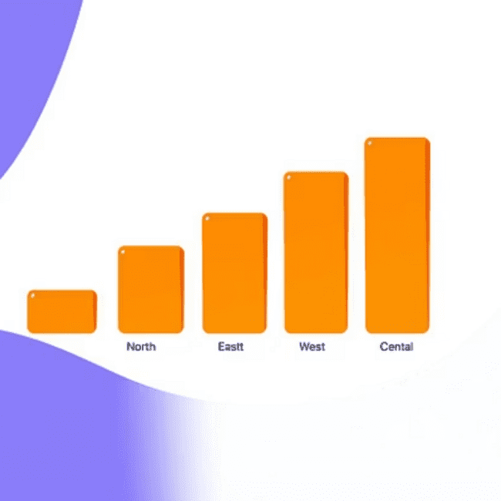
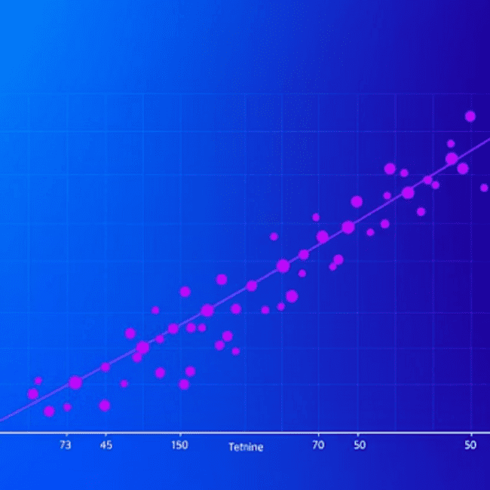
STEP 6: Create Visualizations
Visualizing sales data helps in quickly identifying trends, patterns, and outliers that might be missed in raw numbers. We generate a comprehensive dashboard with several key plots.

Slide 8

STEP 7: Advanced Analytics
Beyond basic statistics, advanced analytics reveals deeper relationships within the data. We explore correlations and seasonal patterns, and segment customers for targeted insights.
Correlation Analysis
Seasonal & Age Group Analysis
Understanding how numeric variables relate to each other.
Seasonal Performance: Analyze sales trends across Winter, Spring, Summer, and Fall to identify peak periods and inform marketing campaigns.
Quantity
1.000
0.015
0.009
0.014
0.244
Customer Segmentation: Group customers by age (e.g., 18-25, 26-35, 36-45, 46-55, 55+) to understand demographic purchasing behaviors.
Unit_Price
0.015
1.000
-0.015
0.008
0.970
Cust_Age
0.009
-0.015
1.000
0.006
-0.010
Cust_Sat
0.014
0.008
0.006
1.000
0.012
Net_Sales
0.244
0.970
-0.010
0.012
1.000

Slide 9
STEP 8: Key Insights & Recommendations
Translating data into actionable insights is the ultimate goal. Based on our analysis, we formulate key findings and strategic recommendations.
Key Insights
Recommendations
Best performing month: August
Focus marketing efforts on Books.
Top product category: Books
Replicate East region strategies elsewhere.
Leading region: East
Investigate August success factors for other months.
Average customer satisfaction: 3.02/5
Improve customer satisfaction.
These recommendations provide a clear roadmap for enhancing sales performance and customer engagement.

Slide 10

STEP 9: Export Results & Conclusion
The final step involves summarizing our findings and ensuring the processed data is ready for future use or sharing. This reinforces the project's impact and facilitates subsequent analysis.
Summary Statistics
Total Revenue
$420,000.00
Average Order Value
$428.62
Total Transactions
980
Average Customer Age
40.3 years
Average Satisfaction
3.02/5
Analysis Complete! Data ready for further use.
Comprehensive Code Generated
The complete step-by-step Google Colab code has been prepared, covering:
Data creation/loading
Cleaning and preprocessing
Descriptive statistics
Multiple visualizations
Advanced analytics
Business insights
Export functionality

